Slide 1
Intraretinal cyst fluid detection using Deep Learning
Group No. 3 (Pedro, Tristan, Gabriel, Julius)

Slide 2
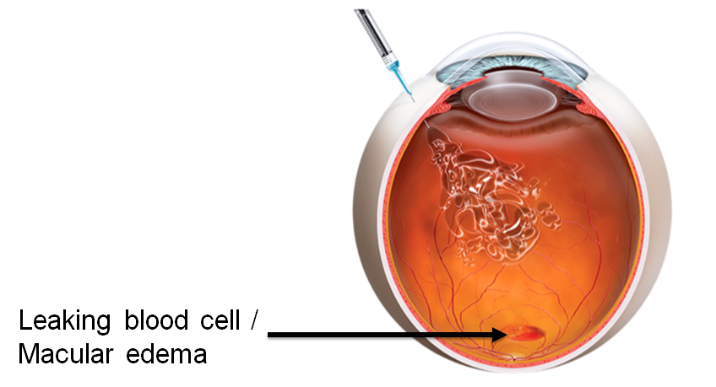
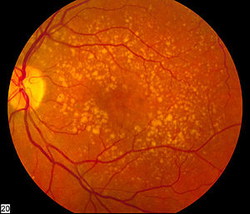
Overview
Age-related macular degeneration (AMD) is the most prevalent cause for blindness in the developed world
Current solution: anti-VEGF intravitreal injections:
accurate assessment of individual disease activity
Evaluate location, size and evolution of fluid, such as intraretinal cysts.
This is a very effective way of delivering medication to the retina -http://precisioneyeclinic.com.au
Notes:
https://en.wikipedia.org/wiki/Anti%E2%80%93vascular_endothelial_growth_factor_therapy
Image: http://precisioneyeclinic.com.au/intravitreal-injections/

Slide 3

About the treatment
Effectiveness depends on:
frequent monitoring
early detection of the disease
Cons:
anti-VEGF drugs are expensive
have to be administered frequently for an extended period of time.
Risks:
“Injecting any medication into the eye may result in complications. It is possible that you may get an infection within your eye (endophthalmitis) as a result of the intravitreal injection. The risk of this is low (estimated at less than 1 per 1000 injections). An infection may lead to vision loss or, in rare cases, loss of the eye”. - http://precisioneyeclinic.com.au.

Slide 4
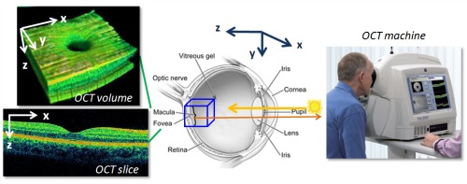
Optical coherence tomography (OCT)
Treatment assessment via visualization with spectral domain optical coherence tomography (SD-OCT) imaging.
“OCT is a noninvasive imaging technology used to obtain high resolution cross sectional images of the retina which is especially important for conditions such as macular degeneration and diabetic retinopathy. This procedure is similar to ultrasound technology except the imaging is performed by light rather than sound. This enables the measurement of the retinal nerve fiber thickness for glaucoma and other neurological conditions.” -http://www.baysteyecare.com/
Notes:
Body text: http://www.baysteyecare.com/optical-coherence-tomography-oct/
Image: http://www.baysteyecare.com/optical-coherence-tomography-oct/

Slide 5
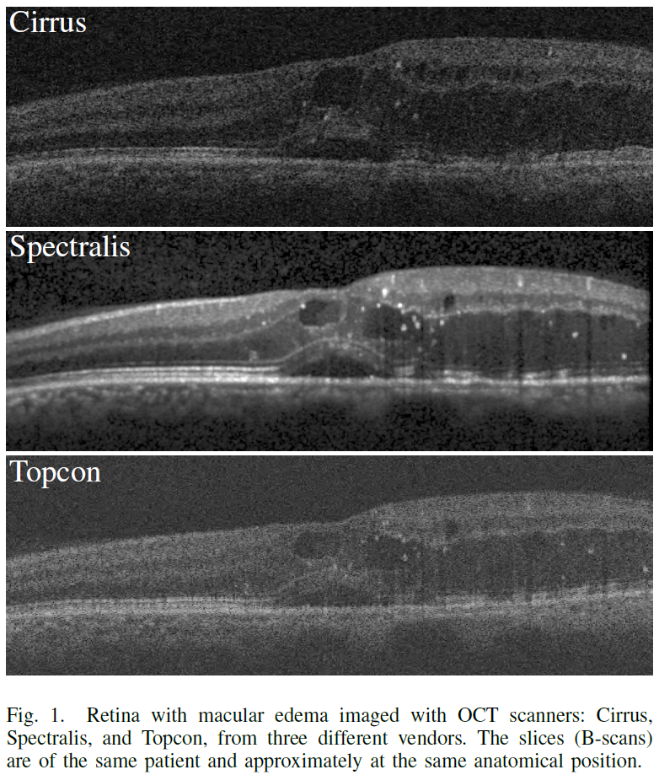
Problems with Optical coherence tomography
The acquired image quality and scan density can vary widely between different OCT device vendors as demonstrated in the Fig1. It can be observed that the highest image quality was produced by Spectralis scanner, which reduces the noise by averaging multiple B-scans of the same anatomical location at the expense of acquiring fewer B-scans. [Freerk G., 2018].
1
Notes:
Body text: https://eyewiki.aao.org/Optical_Coherence_Tomography

Slide 6

Current situation
Currently, this is a manual process, performed by the treating clinician and requires a large amount of time for every treatment.

Slide 7

Goal: to provide expert support to clinicians during treatment decision and to substantially improve the quality of AMD care

Slide 8
Why? Detecting fluid (type) accumulation areas, is important in determining the best treatment option and treatment efficacy

Slide 9
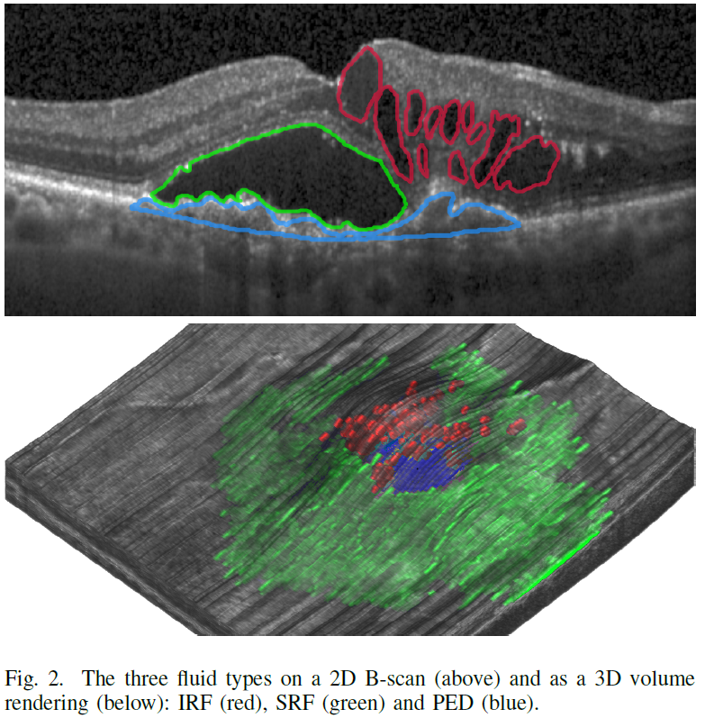
Three types of fluid on OCT
Three types of fluid (Fig. 2) are clinically distinguishable on OCT images and are considered relevant imaging biomarkers for visual acuity and retreatment indication.
a) Intraretinal Fluid (IRF)
b) Subretinal Fluid (SRF)
c) Pigment Epithelial Detachment (PED)
Notes:
Important: We want to segment/detect IRC, which is subpart of IRF. We do not want to segment the others.

Slide 10
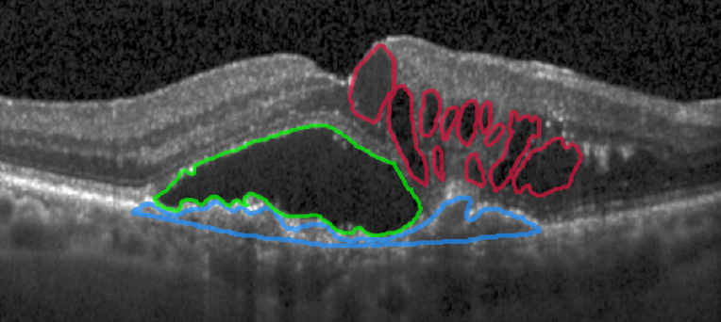
Cystoid fluid: Intraretinal Fluid (IRF)
Intraretinal Fluid (IRF): It consists of contiguous fluid-filled spaces containing columns of tissue as the arrangement of such spaces is determined by the Müller fibres, which are vertical. These spaces when viewed on OCT may appear as separated hyporeflective cystoid pockets hence sometimes such fluid is also referred to as cystoid fluid.

Slide 11
Data Exploration

Slide 12
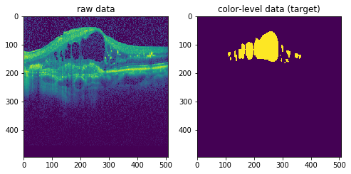

Data Preprocessing
.mhd
array
Images
List
Raw Data
Numpy array
Visualize the data
List of scans
cyst_segmentation_ISMI_training_set |-images |-pat001_im001.mdh |-pat001_im001.raw |-... |-annotations |-pat001_im001.mhd |-pat001_im001.zraw |-...
Convert the ITK image into numpy format
122 Volumes consisting of 18-36 B-scans
80/20 Training/Validation 2937 Training Images 734 Validation Images Each Images has a name corresponding to a volume

Slide 13
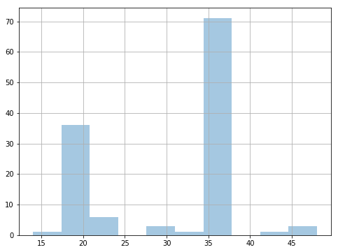
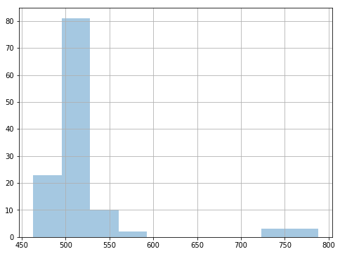
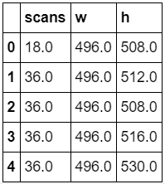
Data histograms
122 Volumes consisting of 18-46 B-scans
Distribution of B-scans/Volume Frequencies of B-scans height
(same width always)
We need to crop the images

Slide 14
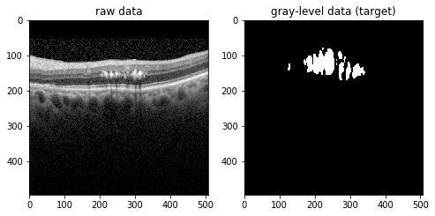
B-scan with corresponding annotation

Slide 15
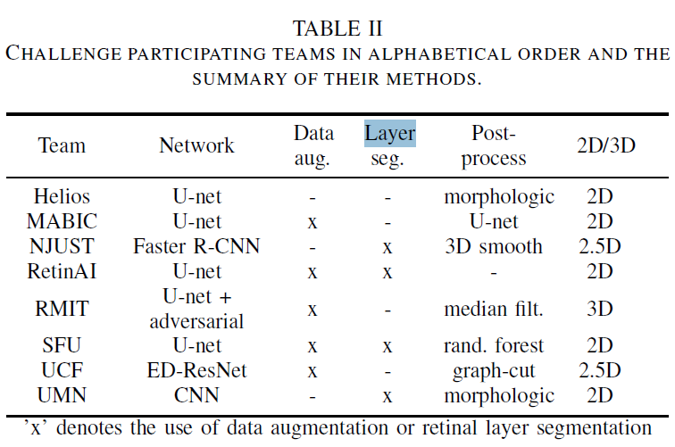
RETOUCH Challenge results

Slide 16
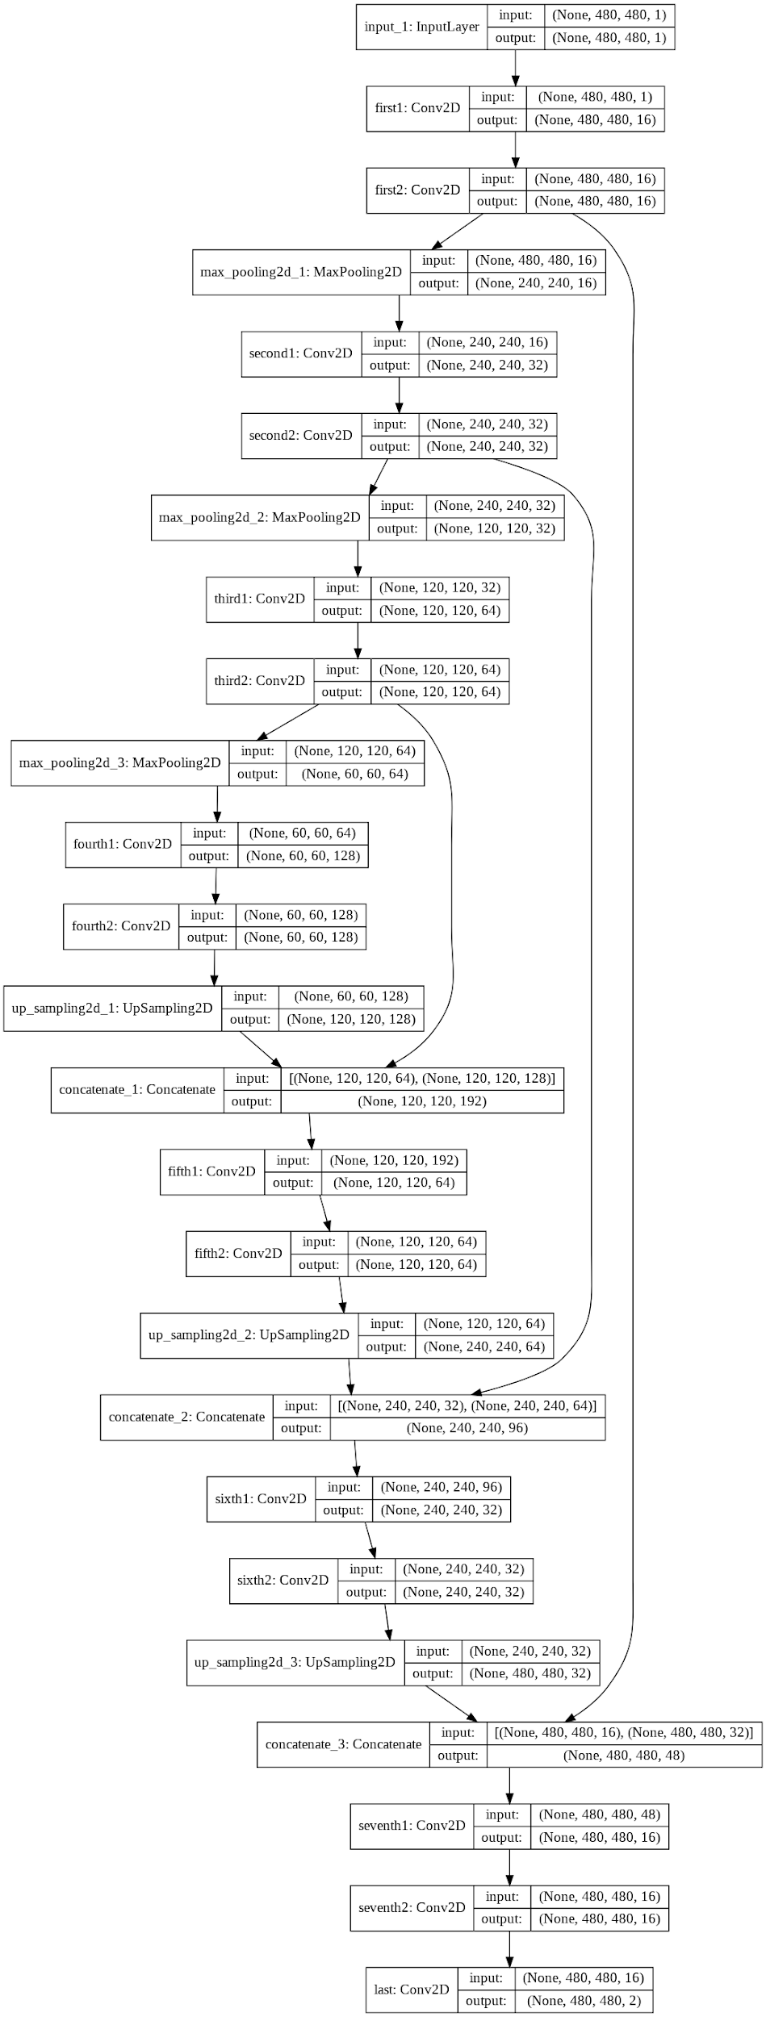
FCNN Architecture
7 unet blocks consisting of 2 Conv2D layers and BatchNormalization…(Assignment 7)

Slide 17

Current Results
WE SUCK

Slide 18
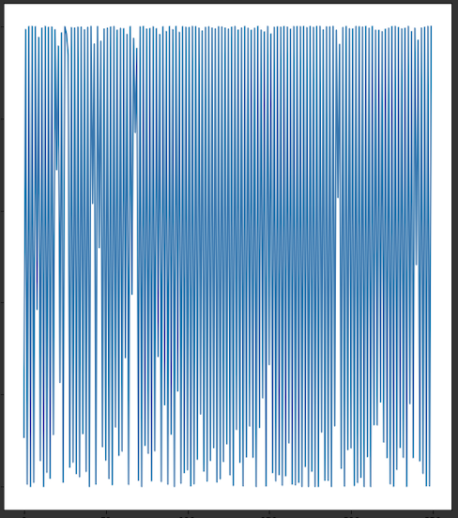

Current Loss and Dice score
Loss Dice score (0.0)

Slide 19
Plan
Investigate what is going on by monitoring the network (Tensorboard, other monitoring…)
Fix what is wrong
Improve performance
Perform Post-Processing (check neighboring scans…)
Hyperparameter optimization

Slide 20


Slide 21
References
[1] Freerk G. Venhuizen, Bram van Ginneken, Bart Liefers, Freekje van Asten, Vivian Schreur, Sascha Fauser, Carel Hoyng, Thomas Theelen, and Clara I. Sánchez, "Deep learning approach for the detection and quantification of intraretinal cystoid fluid in multivendor optical coherence tomography," Biomed. Opt. Express 9, 1545-1569 (2018)
[2] H. Bogunović et al., "RETOUCH -The Retinal OCT Fluid Detection and Segmentation Benchmark and Challenge," in IEEE Transactions on Medical Imaging. doi: 10.1109/TMI.2019.2901398 keywords: {Retina;Image segmentation;Diseases;Biomedical imaging;Image analysis;Fluids;Benchmark testing;Evaluation;Image segmentation;Image classification;Optical Coherence Tomography;Retina}, URL: http://ieeexplore.ieee.org/stamp/stamp.jsp?tp=&arnumber=8653407&isnumber=4359023
A. Montuoro, S. M. Waldstein, B. S. Gerendas, and U. Schmidt-Erfurth, “Joint retinal layer and fluid segmentation in OCT scans of eyes with severe macular edema using unsupervised representation and auto-context,” Biomed. Opt. Express, vol. 8, no. 3, pp. 182–190, mar 2017.

